Slide 1
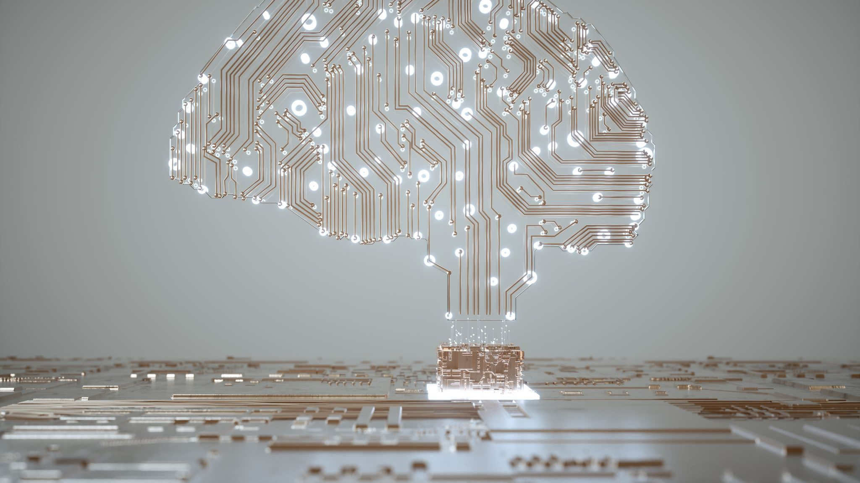
Artificial Intelligence
Carlos A. Acevedo Morales
Diego A. Santiago Uriarte

Slide 2

What is an Artificial Intelligence?
It is the intelligence that is displayed by machines in order to solve a task that would normally require a human to achieve. For example, the task of drawing a picture from a description would normally be a task only a human could do.

Slide 3

What is an Artificial Intelligence?
These machines also have the ability to learn and further develop themselves through the use of Machine Learning. Machine Learning is a form of “teaching” the AI to perform certain tasks. As such, the AI can practice a task and become better at it with each learning session.

Slide 4
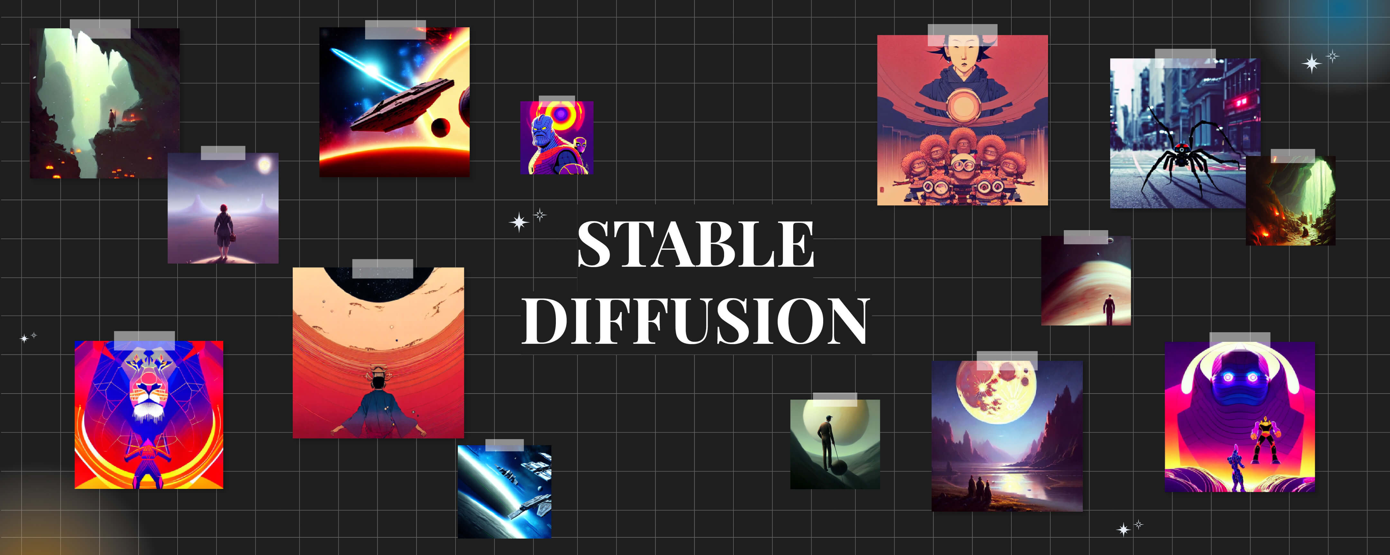
Demonstration of Different AI Technologies Used Today

Slide 5
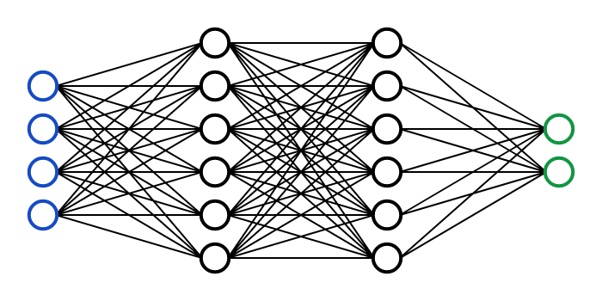
What is An Artificial Intelligence?
Machine Learning is fundamental in the process of building and using AI in our projects.
Some machines use the concept of Neural Networks, which are structurally designed after the human brain architecture. This architecture has vastly improved the performance of AI in many fields.

Slide 6
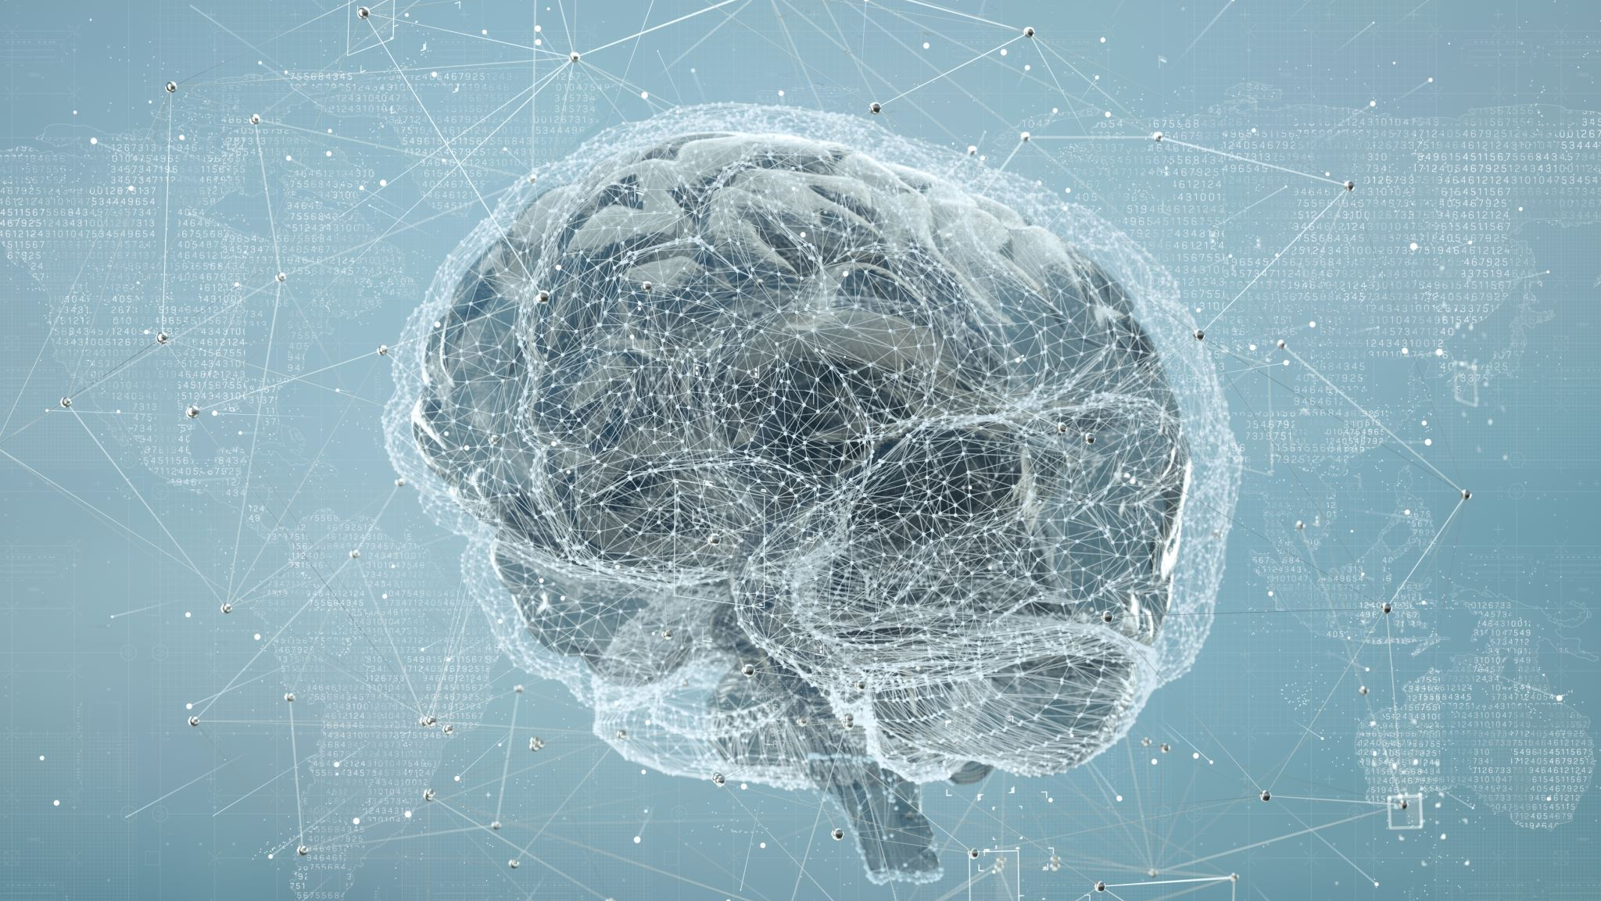
Different Types of Artificial Intelligence

Slide 7

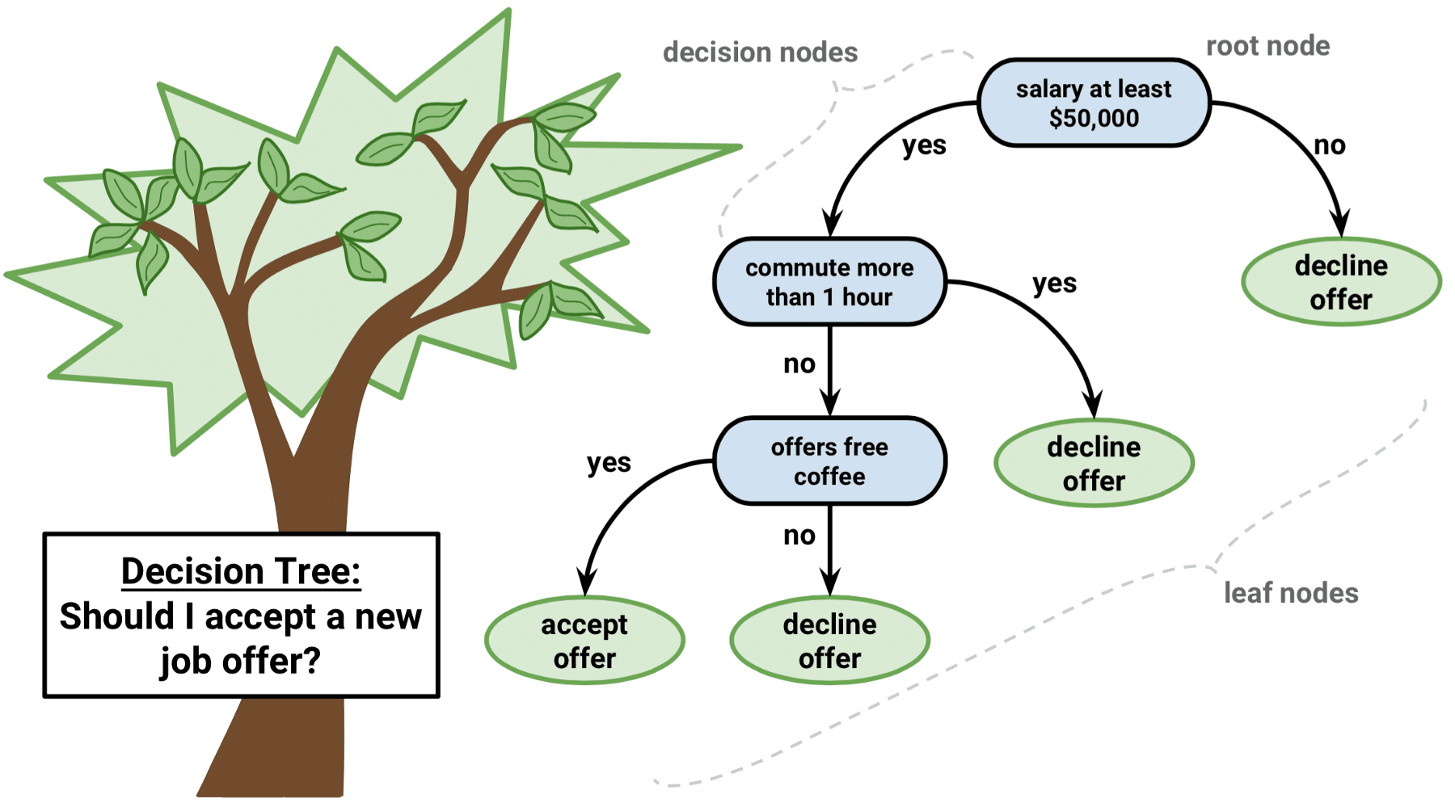
Different Types of Artificial Intelligence
Artificial Intelligence can vary in complexity, some may not even seem like Artificial Intelligence at all.
On the top we observe ChatGPT, a popular AI technology that is highly advanced
Below we can observe a flowchart which can be defined as an AI as well.

Slide 8

Different Types of Artificial Intelligence
Here are some real world applications that you may have seen:
ChatGPT: A very helpful and intelligent chatbot.
Image Generation: A useful tool for artists and non-artists for projects.
Object Detection: A fantastic way to implement smart systems for collision avoidance, filters, security systems, etc.
Pattern Recognition: A great way for scientists to revise their data rapidly.

Slide 9
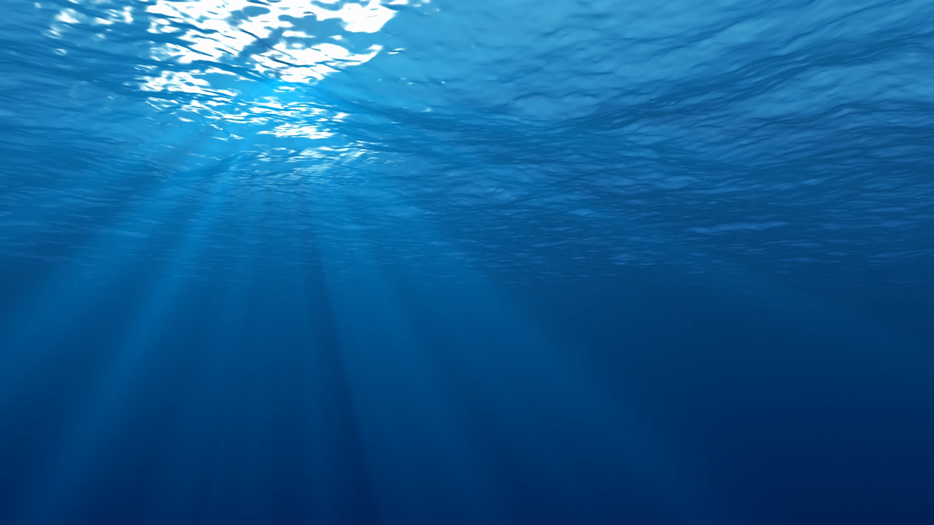
Applications of Artificial Intelligence in Marine Robotics

Slide 10
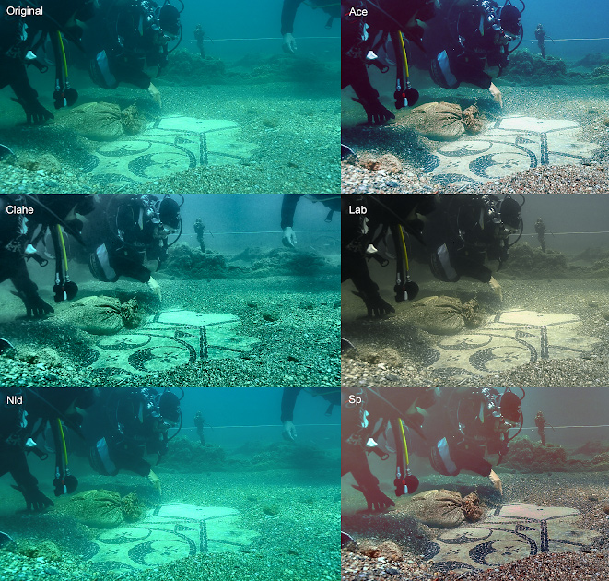
Applications of Artificial Intelligence in Marine Robotics
Object Detection:
Allows Autonomous Surface Vehicles to avoid obstacles
Take snapshots of objects of interest.
Image Classification when analyzing data.
Edge Detection:
Allows for precise maneuvers underwater or on the surface.
Provides detailed images of the overall structure of the ocean floor
Image Processing:
Allows for image clean up if they are too blurry or underwater.

Slide 11
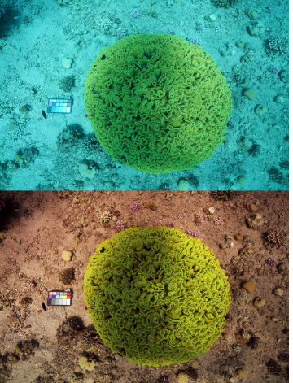
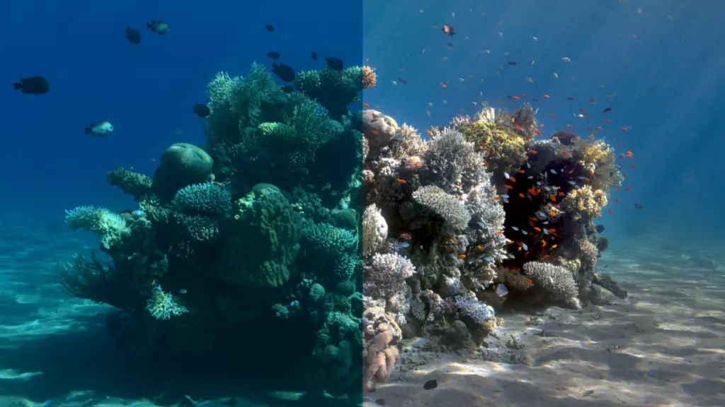
Applications of Artificial Intelligence in Marine Robotics

Slide 12

Demonstration of Different AI Technologies Used Today

Slide 13
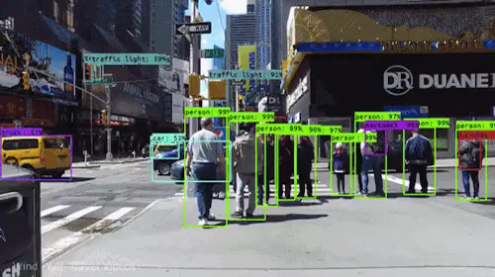
Demonstration of Different AI Technologies Used Today

